Slide 1
OARRS Administrator Training
5/15/2012
Notes:
Instructor Notes and Comments:
For training conducted at the CEOC, use split screens: OARRS on ½ and the PowerPoint on ½
Make sure you provide students with a copy of the PowerPoint so they can follow along with the instruction and make notes.
If someone is trying to register for OARRS access but gets an error message that the user name already exists (example: jsmith), ask that person to re-register using first and middle initial and last name (example jlsmith). If that doesn’t work, have them add the number 1 after their last name increasing the number until the name is accepted (example: jlsmith2).

Slide 2
What is an OARRS Account Administrator?
An OARRS Account Administrator is the person(s) who approves the personnel from your jurisdiction or agency to have access to the system. Each jurisdiction or agency is responsible for deciding who will or will not have access to OARRS.
Each jurisdiction or agency will have at least one (1) account administrator.
5/15/2012
Notes:
No one else from a jurisdiction/agency can approve new OARRS requests so students need to make sure there is more than just one approver per jurisdiction/agency.

Slide 3
Responsibilities Of Account Administrators
You are responsible for:
Approving or denying OARRS access.
Ensuring those approved are trained to use OARRS.
Tracking OARRS training
Maintaining an up-to-date list of approved users
Notifying users of system changes, maintenance and updates
Ensuring users access the system on a regular basis
5/15/2012
Notes:
Jurisdictions and agencies will determine the policy for who will have access to OARRS. It is the responsibility of the Account Administrator to approve or deny requests based on that policy.

Slide 4
Who Should Have OARRS Access?
Jurisdictions and agencies decide who in its organization will have access to OARRS.
OARRS access is limited to those personnel who have either a direct role in the OAEOC/CEOC or are authorized by jurisdictions or agencies to communicate with OAEOC or CEOC.
Example: You would want several EOC or DOC staff per work shift to have access to OARRS.
5/15/2012
Notes:
Note: Users and account approvers should be identified for each Operational Period for all emergency events, incidents and planned activities.

Slide 5
How Does Your Staff Sign Up for OARRS Access?
At the OARRS website portal, click on the “Register” button and it will take them through the registration process.
OARRS website is: https://oarrs.lacounty.gov
When the registration form is completed you, the jurisdiction or agency OARRS Account Administrator, will be notified via email that someone is requesting OARRS access.
You will either approve or deny their access to OARRS. The requestor will be notified via the email address they provided as to the status of their request.
5/15/2012
Notes:
A Registration How To Guide is located in OARRS in the Document Library.
Note: The OARRS administrator should keep copies of the Registration How To guide for those employees wanting to request OARRS access.

Slide 6
Approving A Request
5/15/2012

Slide 7
Notification of Request for Access
You will receive an email notification from OARRS Tech Support that someone from your jurisdiction/agency is requesting OARRS access.
Email will have a subject line: OARRS account registration request
Log into the OARRS Operations database using your User ID and Password.
5/15/2012
Notes:
Note:
OARRS administrators need to add the OARRS Tech Support email to your address book to ensure your jurisdiction/agency SPAM filters do not block emails from this account.
OARRS Administrators also need to frequently check OARRS as there are no email reminders that there are pending requests.
Remember: OARRS account requests are found only in the Operations environment, not in Training.

Slide 8
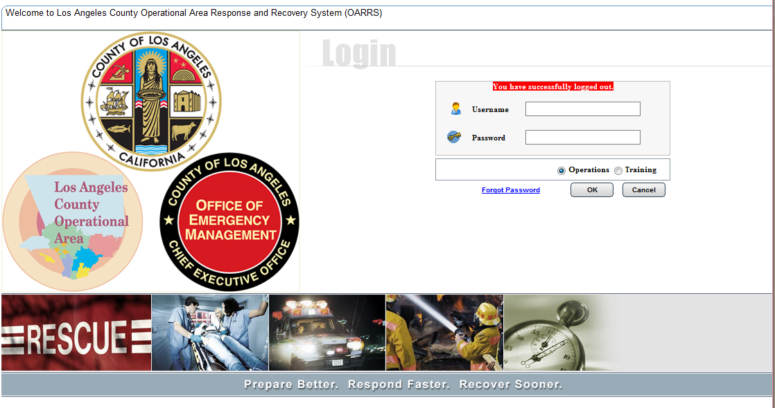
Note: The ability to approve users does not exist in the OARRS Training environment so you must be logged in to Operations
5/15/2012
Notes:
If you have inadvertently logged in to the training environment, make sure you log out of training using the logoff tab across the top of the menu bar. If you close out using your browser, you may get locked out of the system.

Slide 9
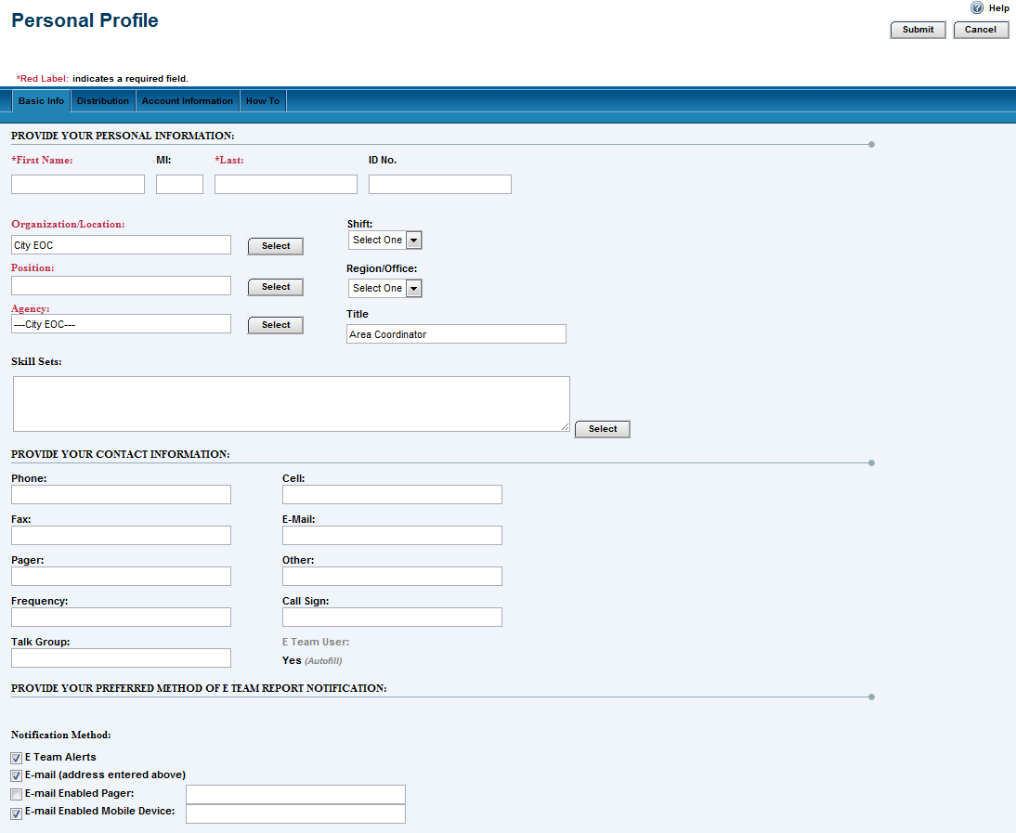
The first screen that appears is your Personal Profile
Review your information for accuracy and click on Submit
5/15/2012
Notes:
It is important to always check to make sure your contact numbers and email are current and accurate.

Slide 10
Helpful Hint
Notes:
This is a really important tip!
Remember to ALWAYS logoff from the OARRS menu bar and NOT from your web browser in the top right corner. If you close out from your web browser, the system could lock you out of the system for an extended period of time!

Slide 11
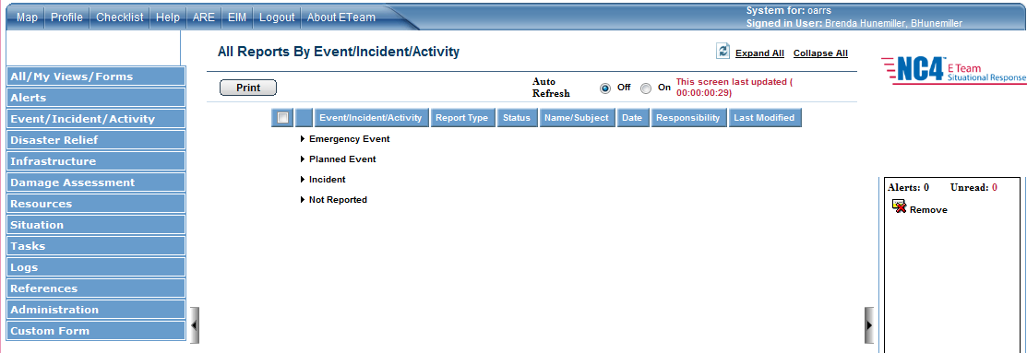
Click the Administration link in the left frame
5/15/2012
Notes:
Only Account Administrators can see the Administration tab on the Navigation menu.
Helpful Tip: Take a moment to set the Auto Refresh button to On. It will update the screen on a regular basis.
Instructor’s Note:
If the students don’t see the Administration Tab they are either in the Training Environment or they do not have Administration Rights or they have not selected from approved list.

Slide 12
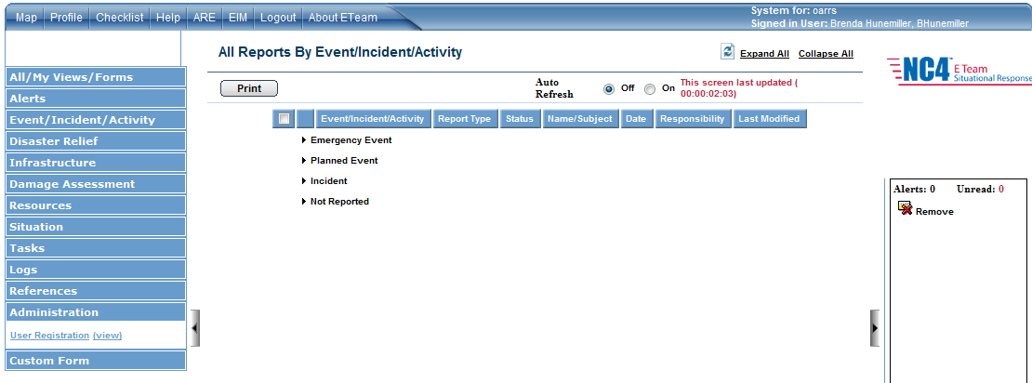
Click the User Registration link
5/15/2012

Slide 13
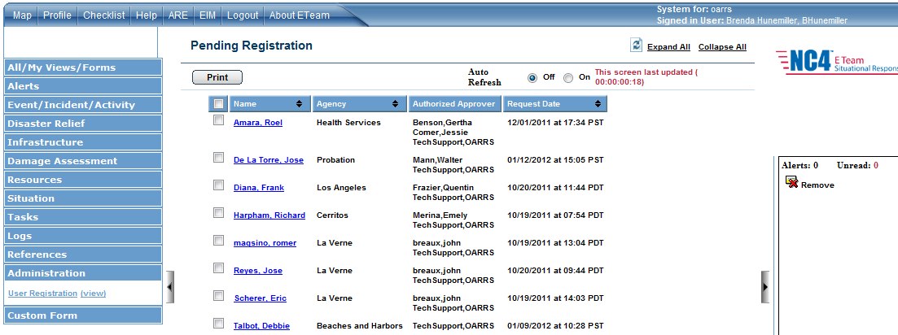
The system displays the Pending Registration view
5/15/2012
Notes:
This is a list of everyone awaiting approval, not just the people for your jurisdiction or agency.
You will only be able to approve or deny access for your own jurisdiction or agency.

Slide 14
Click the blue Name link for the person requesting access. Your name will be listed as an Authorized Approver
5/15/2012
Notes:
If your jurisdiction/agency has more than one approver, all of them will be listed such as the example you see here by the red arrow.
Instructor’s Note: Tell students to ignore the blank check box. That box is checked only if you wish to print the info for that person.
Do not click on the blue link UNLESS you are the Account Approver listed for that person and agency.

Slide 15
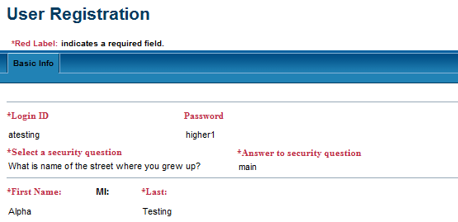
Verify:
Logon ID – first initial and last name protocol
Use lower case
If this protocol is not used, deny access and notify user to re-register using the correct protocol
5/15/2012
Notes:
Helpful Hint: Recommend using a temporary password when registering and then change password when the account is approved
Helpful Hint: To verify proper protocol – check Login ID against the first/last name rule

Slide 16
Verify:
Organization/Location
If a city employee, City EOC must be selected
If a county employee, either County DOC or CEOC assignment must be selected
5/15/2012

Slide 17
Verify:
Position
If a city employee, EOC position/assignment must be selected
If a county employee, either department DOC or CEOC position/assignment must be selected
5/15/2012
Notes:
Position must be their EOC assignment and not their day to day job assignment.

Slide 18
Verify:
Agency
If a city employee, your city name must be listed
If a county employee, your department name must be listed
5/15/2012
Notes:
City employees should NEVER select a department as the agency; it should always be the city name.

Slide 19
Verify:
Shift
As shift assignments may vary based on any given incident, the work shift at time of registration is not critical
5/15/2012
Notes:
EOC Shift assignments may change on a daily basis. For the purpose of registration, this is not a critical element.

Slide 20
Verify:
Region/Office:
If a city employee, City EOC should be selected
If a county employee, CEOC or DOC should be selected
5/15/2012

Slide 21
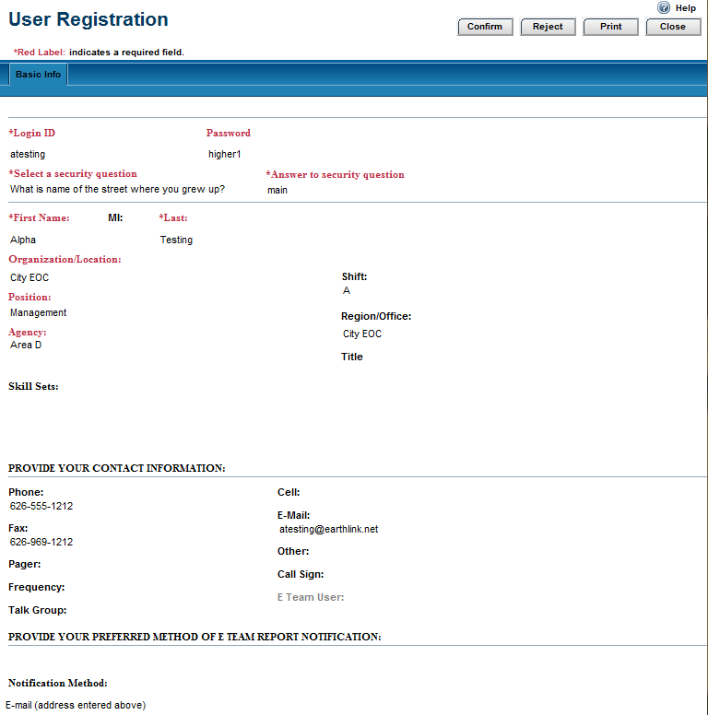
Verify:
All contact information is complete
5/15/2012
Notes:
If the OARRS user wants to receive text messages from OARRS, they must enter their number in “Personal Profile” at the bottom of the page where it reads:
E-mail Enabled Mobile Device
Make sure the box is checked.

Slide 22
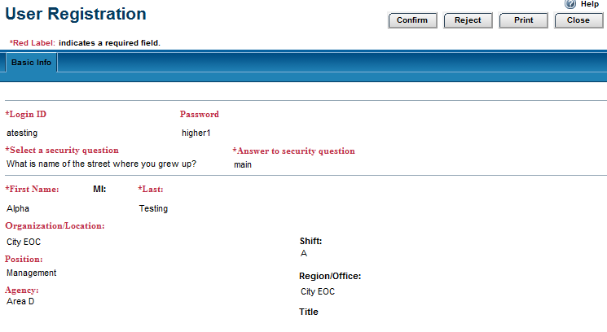
When all information has been verified:
Click the Confirm button
5/15/2012

Slide 23
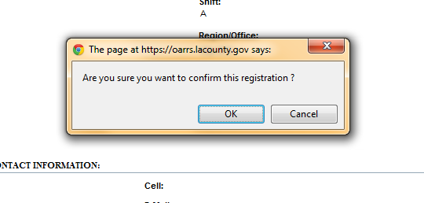
You will be asked if you want to confirm the registration
If yes, click on OK
5/15/2012

Slide 24
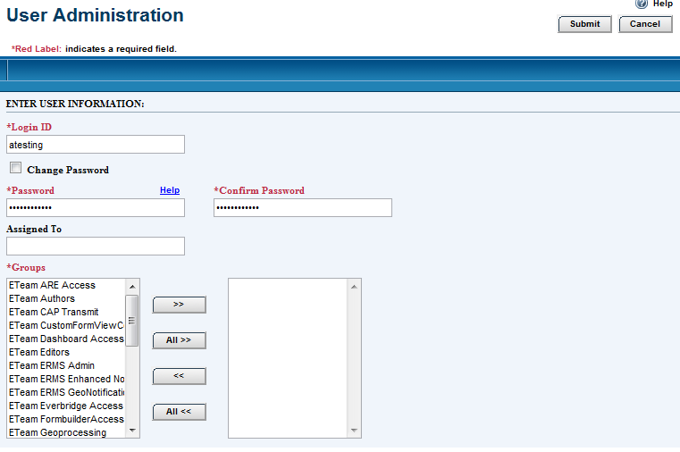
Access to OARRS Functions
THIS STEP IS REQUIRED!
Find “ETeam Editors” group in the Group list box on the left (you may have to scroll).
Select by clicking on “ETeam Editors” group on the left and click the “>>” button to move the “ETeam Editors” group over to the list box on the right.
5/15/2012
Notes:
You must select ETeam Editors or the person will not have access to the functions of OARRS.
Note: For a person to be added as an Account Administrator, the request must go to TAG. An existing Account Administrator for your jurisdiction/agency cannot give that permission or level of access.

Slide 25
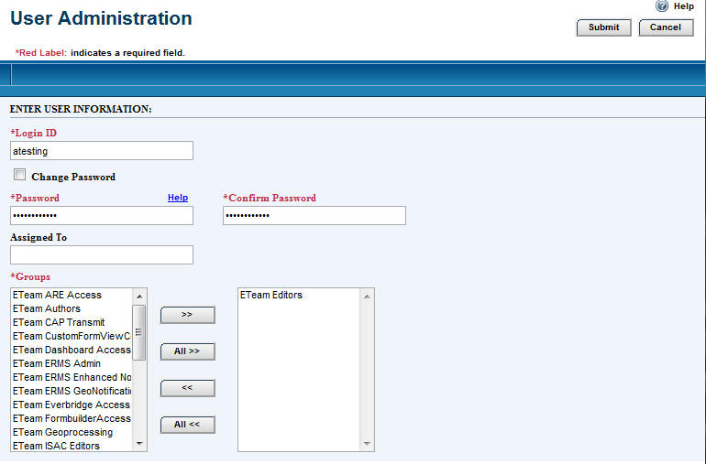
Note: ETeam Editors is the only selection you should choose. It now appears in the right-hand column
5/15/2012

Slide 26
Click on the Submit button
5/15/2012

Slide 27
The system displays the User Administration in the Read mode
Click on the Close button
5/15/2012
Notes:
The User Administration view is a summary of the access to the OARRS functions (Eteam Editors).

Slide 28
OARRS Tech Support will send the person an email stating their OARRS access has been approved.
5/15/2012

Slide 29
To Reject A Request
5/15/2012

Slide 30
Reasons to reject/deny a request:
Person should not have OARRS access
Person is not in your jurisdiction/agency
If the correct Username protocol is not used
An incorrect Organization/Location, Position, Agency was selected
If person already has an OARRS account
Review User Directory
If this is a shared account
Email is their personal email and not their jurisdiction/agency email
5/15/2012
Notes:
The User Directory is located in the Navigation menu on the left under the References tab. The directory is sorted by last name.

Slide 31
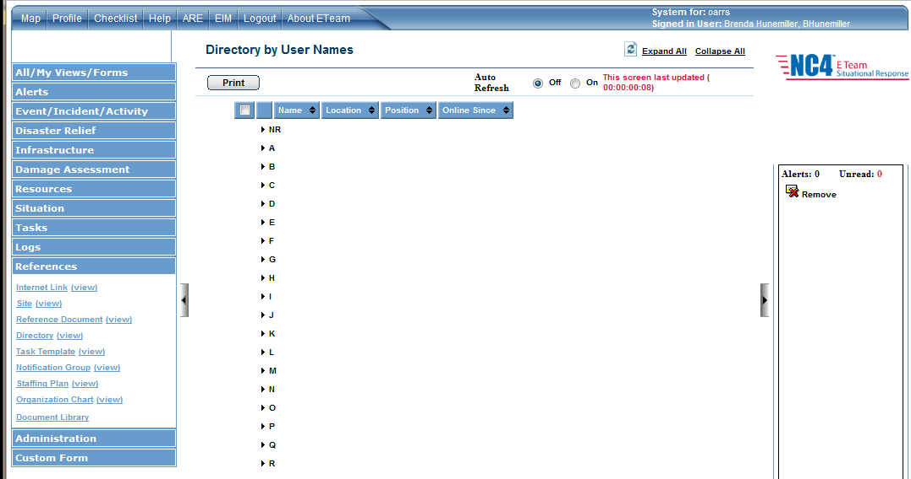
Notes:
The User Directory is under References. Just click on Directory for an alphabetical listing, by last name, of all Users

Slide 32
If you are going to reject a request:
Do this BEFORE you click on the Reject button.
First, copy and paste the person’s email address to your email application and send an email explaining why you are rejecting their request.
Click on the Reject button
5/15/2012
Notes:
The system will send an email that the request has been rejected; however, it does not explain why it was rejected. Account Administrators need to send an email explaining why the request was rejected

Slide 33
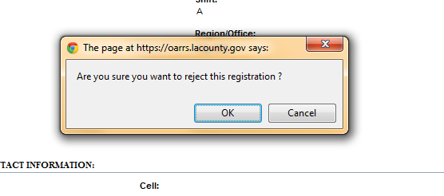
You will be asked if you want to reject the registration.
If yes, click the OK button.
An automated email will be generated from OARRS Tech Support stating their OARRS access has been denied. It will not explain why it has been denied.
The Account Administrator’s email will explain why access has been denied.
5/15/2012

Slide 34
Maintenance
It is the responsibility of each Account Administrator(s) to maintain a current and up to date list of their users
If the Account Administrator changes, notify OARRS Technical Support of the new Administrator
Accounts should be reviewed on a regular basis for accuracy
5/15/2012
Notes:
Instructor’s Note:
If your jurisdiction/agency Administrator changes or needs to be removed, it is important to notify TAG immediately.

Slide 35
Maintenance
It is the responsibility of the Account Administrator(s) to notify OARRS Technical Support at: OARRSTechSupport@ceo.lacounty.gov of any account user who is no longer with their jurisdiction/agency as soon as possible.
5/15/2012

Slide 36
Maintenance
Accounts inactive for one (1) year will be deleted from the system due to inactivity.
An Account Administrator can request an Account User List Report for your jurisdiction/agency by contacting OARRSTechSupport@ceo.lacounty.gov
5/15/2012
Notes:
Instructor’s Note:
It is important as the OARRS Administrator that you encourage your jurisdiction/agency users to participate in the monthly OARRS tests.

Slide 37
OARRS Training
Account Administrator(s) are responsible for notifying their users of OARRS training opportunities, which include:
Basic OARRS training
Monthly online exercise
Use of OARRS during jurisdiction/agency exercises
Administrators should check the Splash Page for New Features added to OARRS
How To Guides are located in the Document Library
5/15/2012
Notes:
As the Account Administrator, you will most likely be looked at as the “subject matter expert” for OARRS so make sure you have a good working knowledge of OARRS and be prepared to answer questions about basic OARRS issues.

Slide 38
QUESTIONS?
5/15/2012
Notes:
What is OARRS and why am I here??????

